Slide 1




Lesson 7: Information Extraction (IE)
Haihua Chen, Ph.D.
Assistant Professor
9402200057
Haihua.chen@unt.edu
1/11/26

Slide 2

Agenda
1
Introduction to IE
2
IE Tasks
3
IE Techniques
4
Challenges for IE
5
IE with Python
1/11/26

Slide 3
1
Introduction to IE
1/11/26
Notes:
https://www.analyticsvidhya.com/blog/2019/09/introduction-information-extraction-python-spacy/
https://www.searchtechnologies.com/blog/natural-language-processing-techniques
https://zhuanlan.zhihu.com/p/62847358
https://www.groundai.com/project/lexnlp-natural-language-processing-and-information-extraction-for-legal-and-regulatory-texts/1
https://www.slideshare.net/rubenizquierdobevia/information-extraction-45392844
https://web.stanford.edu/class/cs124/lec/Information_Extraction_and_Named_Entity_Recognition.pdf
https://journalofbigdata.springeropen.com/articles/10.1186/s40537-019-0254-8

Slide 4

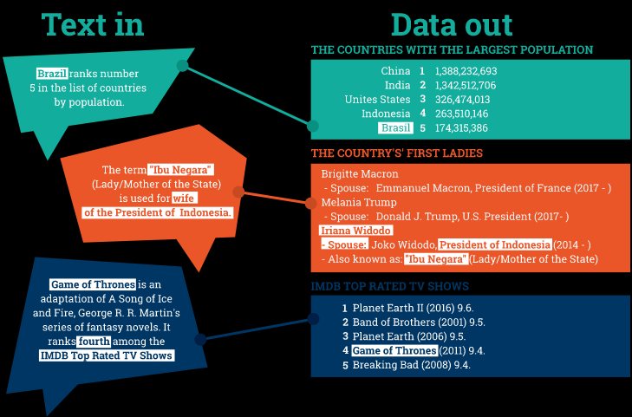



Why Information Extraction
1/11/26

Slide 5
An Example of Information Extraction
“Marc Marquez was fastest in the final MotoGP warm-up session of the 2016 season at Valencia, heading Maverick Vinales by just over a tenth of a second.
After qualifying second on Saturday behind a rampant Jorge Lorenzo, Marquez took charge of the 20-minute session from the start, eventually setting a best time of 1m31.095s at half-distance.”
Person: Marc Marquez
Location: Valencia
Event: MotoGP
Related mentions: Maverick Vinales, Yamaha, Jorge Lorenzo
1/11/26

Slide 6
A Real IE System: NOW platform
Discover new and interesting news, aggregated from various sources in categories.
Enjoy their semantically enriched content and get the advantage of the knowledge behind.
Focus on the trends to see the top mentioned concepts for a particular period of time.
Browse to see articles with similar semantic fingerprints.
News on the Web (NOW): A Showcase of Dynamic Semantic Publishing
1/11/26

Slide 7
Structured, Semi-structured, and Unstructured Text
Structured data is data whose elements are addressable for effective analysis. It has been organized into a formatted repository that is typically a database. It concerns all data which can be stored in database SQL in a table with rows and columns. They have relational keys and can easily be mapped into pre-designed fields.
Semi-structured data is information that does not reside in a relational database but that have some organizational properties that make it easier to analyze. With some process, you can store them in the relation database (it could be very hard for some kind of semi-structured data), but Semi-structured exists to ease space. (XML, Json)
Unstructured data is data that is not organized in a pre-defined manner or does not have a pre-defined data model, thus it is not a good fit for a mainstream relational database. So for Unstructured data, there are alternative platforms for storing and managing, it is increasingly prevalent in IT systems and is used by organizations in a variety of business intelligence and analytics applications. (Word, PDF, Text, Social Media)
1/11/26
Notes:
https://api.semanticscholar.org/v1/paper/10.1145/1008992.1009043
Structured data is data whose elements are addressable for effective analysis. It has been organized into a formatted repository that is typically a database. It concerns all data which can be stored in database SQL in a table with rows and columns. They have relational keys and can easily be mapped into pre-designed fields.
Semi-structured data is information that does not reside in a relational database but that have some organizational properties that make it easier to analyze. With some process, you can store them in the relation database (it could be very hard for some kind of semi-structured data), but Semi-structured exists to ease space. (XML, Json)
Unstructured data is data that is not organized in a pre-defined manner or does not have a pre-defined data model, thus it is not a good fit for a mainstream relational database. So for Unstructured data, there are alternative platforms for storing and managing, it is increasingly prevalent in IT systems and is used by organizations in a variety of business intelligence and analytics applications. (Word, PDF, Text, Social Media)

Slide 8
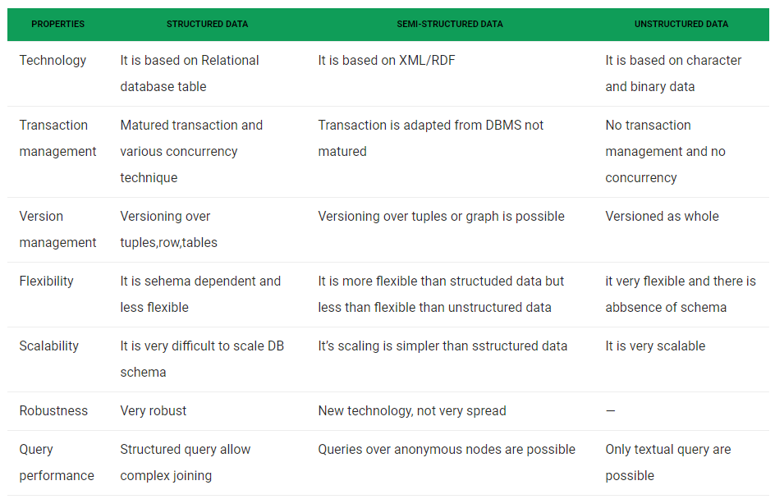
Structured, Semi-structured, and Unstructured Text
1/11/26

Slide 9
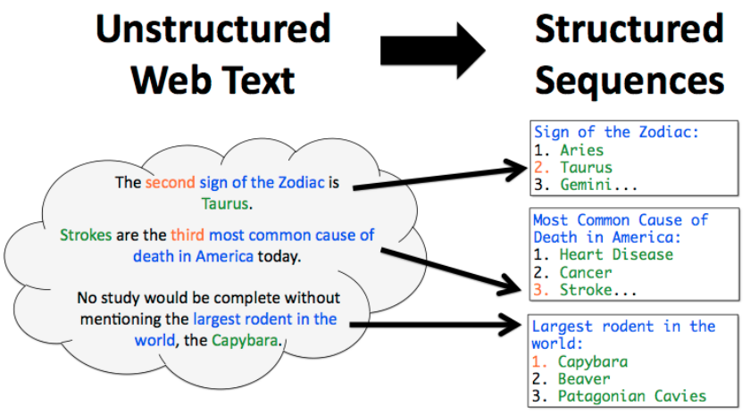
So… What is Information Extraction (IE)?
“IE process extracts useful structured information from the unstructured data in the form of entities, relations, objects, events and many other types.”
1/11/26

Slide 10
What is Information Extraction?
Late 1970s within NLP field.
Find and extract automatically limited relevant parts of texts.
Merge information from many pieces of text.
Quite often in specialized domains.
Also open information extraction
Move from unstructured/semi-structured data to structured data
Linguistic analysis and natural language understanding
1/11/26

Slide 11
Main goals of IE
Fill a predefined “template” from raw text
Extract who did what to whom and when
Organize information so that is useful to people
Put information in a form that allows further inferences by computers
1/11/26

Slide 12
Information Extraction Applications
Question-Answering System
User Profile Extraction
Auto E-mail reply and Auto Calendar
Resume Processing
Classified Advertisements
Customer Services
Building citation database (scientific data mining)
Social Analysis
1/11/26

Slide 13
2
IE Tasks
1/11/26

Slide 14
IE tasks
1/11/26

Slide 15
IE tasks
Extracting entities
e.g.: companies, people, dollar amounts, key initiatives, etc.
Clustering content
to identify main topics of discourse and/or to discover new topics
Fact extraction
to fill databases with structured information for analysis, visualization, trending, or alerts
Relationship extraction
to fill out graph databases to explore real-world relationships
Categorizing content
by positive or negative (e.g. sentiment analysis), by function, intention or purpose, or by industry or other categories for analytics and trending
1/11/26
Notes:
Numerous studies have been conducted on IE, addressing the challenges and issues for different data types such as text, image, audio and video.

Slide 16
IE tasks – Basic extraction
Structure extraction – identifying fields and blocks of content based on tagging.
Identify and mark sentence, phrase, and paragraph boundaries – these markers are important when doing entity extraction and NLP since they serve as useful breaks within which analysis occurs.
Language identification –
Tokenization – to divide up character streams into tokens which can be used for further processing and understanding.
Acronym normalization and tagging – acronyms can be specified as “I.B.M.” or “IBM” so these should be tagged and normalized.
Lemmatization / Stemming – reduces word variations to simpler forms that may help increase the coverage of NLP utilities.
De-compounding – for some languages (typically Germanic, Scandinavian, and Cyrillic languages), compound words will need to be split into smaller parts to allow for accurate NLP.
Phrase extraction – extracts sequences of tokens (phrases) that have a strong meaning which is independent of the words when treated separately.
1/11/26

Slide 17
IE tasks – Macro versus Micro
Macro Understanding – provides a general understanding of the document as a whole or a collect of documents as a whole.
Micro Understanding – extracts understanding from individual phrases or sentences.
1/11/26

Slide 18
IE tasks – Macro Understanding (the whole document or collection)
Classifying / categorizing / organizing records
Clustering records
Extracting topics
General sentiment analysis
Record similarity, including finding similarities between different types of records (for example, job descriptions to résumés / CVs)
Keyword / keyphrase extraction
Duplicate and near-duplicate detection
Summarization / key sentence extraction
Semantic search
1/11/26

Slide 19
IE tasks – Micro Understanding (extracting facts, entities, and relationships)
Extracting acronyms and their definitions
Extracting citation references to other documents
Extracting key entities (people, company, product, dollar amounts, locations, dates). Note that extracting “key” entities is not the same as extracting “all” entities (there is some discrimination implied in selecting what entity is ‘key’)
Extracting facts and metadata from full text when it’s not separately tagged in the web page
Extracting entities with sentiment (e.g. positive sentiment towards a product or company)
Identifying relationships such as business relationships, target / action / perpetrator, etc.
Identifying compliance violations, statements which show possible violation of rules
Extracting statements with attribution, for example, quotes from people (who said what)
Extracting rules or requirements, such as contract terms, regulation requirements, etc.
1/11/26

Slide 20
3
IE Techniques
1/11/26

Slide 21
IE Techniques
Rule-based Approach
Supervised Learning
Semi-supervised Learning
Hybrid approaches
Deep learning

Slide 22
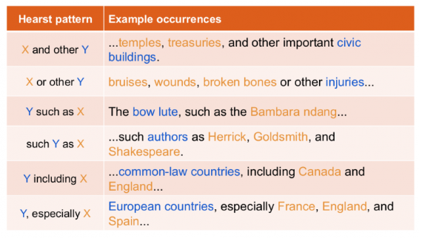
IE Techniques - Rule-based Approach
“We define a set of rules for the syntax and other grammatical properties of a natural language and then use these rules to extract information from text.”
Notes:
https://github.com/philipperemy/information-extraction-with-dominating-rules

Slide 23
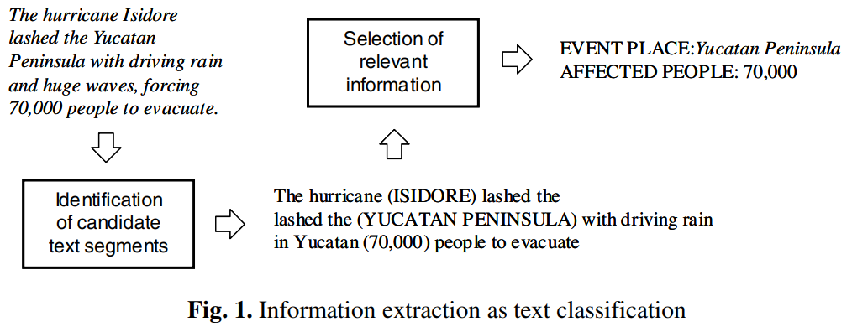
IE Techniques - Supervised Learning
“The use of supervised learning methods in IE applications is mainly focused on the automatic acquisition of the extraction patterns. These patterns are used to extract the information relevant to a particular task from each single document of a given collection.”
Notes:
Téllez-Valero, A., Montes-y-Gómez, M., & Villaseñor-Pineda, L. (2005, February). A machine learning approach to information extraction. In International Conference on Intelligent Text Processing and Computational Linguistics (pp. 539-547). Springer, Berlin, Heidelberg.

Slide 24
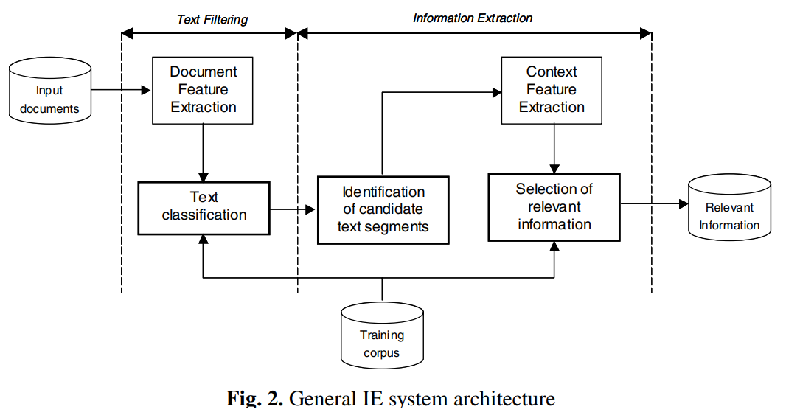
IE Techniques - Supervised Learning
“The use of supervised learning methods in IE applications is mainly focused on the automatic acquisition of the extraction patterns. These patterns are used to extract the information relevant to a particular task from each single document of a given collection.”
Notes:
Téllez-Valero, A., Montes-y-Gómez, M., & Villaseñor-Pineda, L. (2005, February). A machine learning approach to information extraction. In International Conference on Intelligent Text Processing and Computational Linguistics (pp. 539-547). Springer, Berlin, Heidelberg.

Slide 25
IE Techniques - Semi-supervised Learning – why?
Data annotation: labor-intensive and time-consuming, limited available training data for supervised learning.
Label sparsity:
E.g.: medication entities have high lexical variation (medication names, reasons, and durations), challenging supervised ML systems.
Availability of unannotated data
=> opens up the possibility of combining annotated data with unannotated data for training semi-supervised models.
The semi-supervised method (bootstrapping):
automatically annotates unlabeled data
and iteratively introduces these automatic annotations into the training set using a confidence-rated classifier until performance converges.
Notes:
Tao, C., Filannino, M., & Uzuner, Ö. (2018). Fable: A semi-supervised prescription information extraction system. In AMIA Annual Symposium proceedings (Vol. 2018, p. 1534). American Medical Informatics Association.

Slide 26
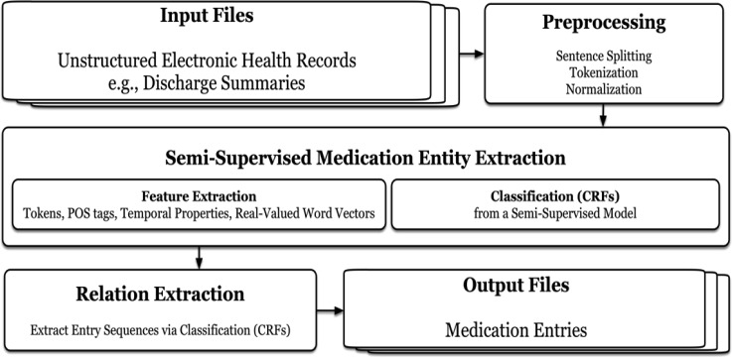
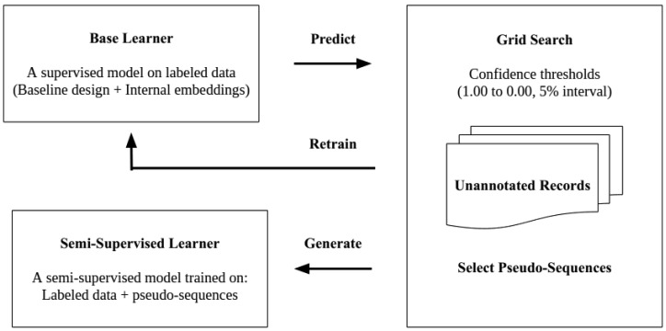
IE Techniques - Semi-supervised Learning
“FABLE employs semi-supervised learning to capitalize on unlabeled data to enhance recognition of sparsely represented, lexically and syntactically diverse medication entities. The unlabeled data also help it compensate for potentially incomplete.”
Tao, C., Filannino, M., & Uzuner, Ö. (2018). Fable: A semi-supervised prescription information extraction system. In AMIA Annual Symposium proceedings (Vol. 2018, p. 1534). American Medical Informatics Association.

Slide 27
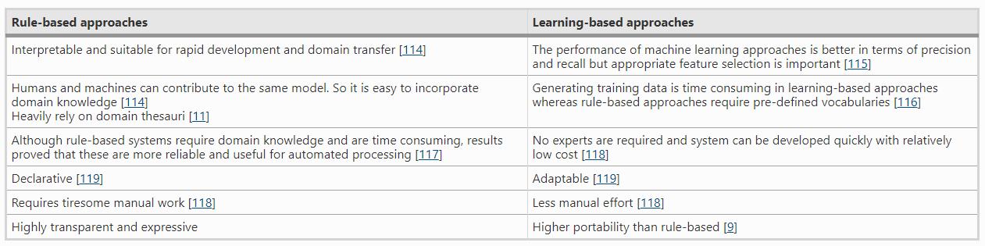
IE Techniques – Rule-based vs Machine Learning-based

Slide 28
IE Techniques - Hybrid approaches
“Hybrid approach refers to the combination between both rule based and machine learning approaches. For example, the tool TextRazor”
The statistical ML approach focuses on extracting entities with regular expressions such as hashtags, emails, phone numbers, etc.
The rule-based method makes use of web resources such as Wikipedia and Freebase to build a dictionary of different entity combinations.
The ML approach is integrated with the rule-based approach.
Abdallah, Z. S., Carman, M., & Haffari, G. (2017). Multi-domain evaluation framework for named entity recognition tools. Computer Speech & Language, 43, 34-55.

Slide 29
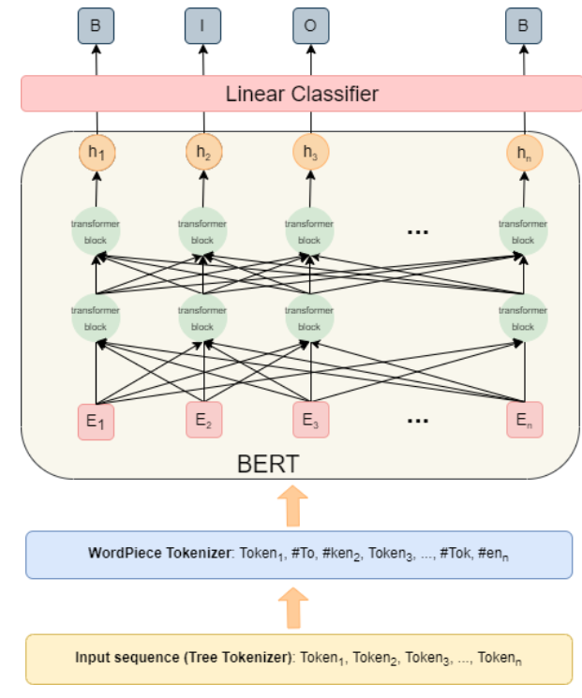
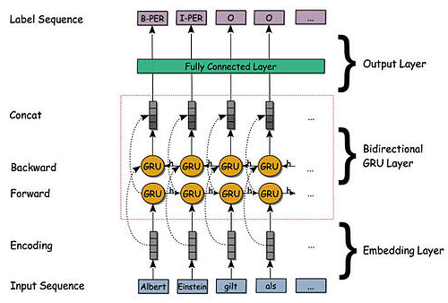
IE Techniques – Deep learning
NER with Bidirectional RNNs
Nguyen, T. H. (2018). Deep Learning for Information Extraction (Doctoral dissertation, New York University).
Keyword extraction with BERT
Notes:
“A bidirectional RNN consists of a so called forward layer and a backward layer. The input sequence is fed to the forward layer in the regular way, while in the backward layer the input is processed in the reverse order, starting from the last word, then proceed to the next to last word and so on up to the first word.
The hidden states are then concatenated for each token generating an intermediate representation sequence. Hence, for each intermediate representation the information from the sequence before and after the respective token are taken into account. That means for each iteration step the network has access to the complete document and can deduce the right label from that information.”

Slide 30
4
Challenges for IE
1/11/26

Slide 31
IE Challenges (Adnan and Akbar, 2019)
Quality of unstructured big data
Data sparsity
Volume of unstructured big data
Dimensionality and heterogeneity
Data usability
Context and semantic understanding
Data modeling
Adnan, K., Akbar, R. An analytical study of information extraction from unstructured and multidimensional big data. J Big Data 6, 91 (2019). https://doi.org/10.1186/s40537-019-0254-8

Slide 32
IE Challenges - Quality of unstructured big data
Noise, missing data, incomplete data and low quality data are major quality issues of unstructured big data that degrades the performance of IE process. The quality issues of unstructured big data are huge barriers in extracting useful and most relevant information that makes IE process arduous. Quality improvement, early in the process, is the utmost requirement of IE from unstructured big data.

Slide 33
IE Challenges - Data sparsity
The enormous growth of user-generated content increased the data sparsity (a.k.a. data sparseness and data paucity) issues where only small fraction of data contains interesting and useful information. Text analysis of social media data, summarization of visual data are directly associated with user-generated content. Due to the sparsity of content, it became difficult to find most relevant representative data to produce semantically rich results. There is a false assumption about large datasets that frequent extractions from large datasets can produce better results. Extracting a small amount of evidence in the corpus to present useful information is a challenge for unstructured big datasets.

Slide 34
IE Challenges - Volume of unstructured big data
Existing techniques should adopt new size and time requirements to deal with IE from big data. Automatic IE and structuring the unstructured big data requires the scaling of existing methods designed for very small data to process millions of data records. Therefore, distributed and parallel computing should be adopted for improved efficacy of IE from unstructured big data.

Slide 35
IE Challenges - Dimensionality and heterogeneity
Unstructured big data comes with high dimensionality, diversity, dynamicity and heterogeneity. Dimensionality reduction and semantic annotation can further improve the IE performance of high dimensional and heterogeneous data respectively. The techniques with high representational power are appropriate for high dimensional data. With the influx of data from increasingly diverse sources, big data IE and analytics require advanced techniques to handle more than data accessibility.

Slide 36
IE Challenges - Data usability
Unstructured big data is a rich source of information but exploitation of relevant information is one of the major challenges. It is more relevant to the optimal data selection with balance of cost, speed and accuracy. The main problem with unstructured big data is, huge deluge of data is available, but it is not usable. Usability of data is defined as the capacity of data to fulfill the requirements of user for a given purpose, area and epoch. Data usability helps to know more about data, its understanding and its usage.

Slide 37
IE Challenges - Context and semantic understanding
Identifying the context of interaction among entities and objects is a crucial task in IE, especially with high dimensional, heterogeneous, complex and poor quality data. Data ambiguities add more challenges to contextual IE. Semantics are important to find relationship among entities and objects. Entities and object extraction from text and visual data could not provide accurate information unless the context and semantics of interaction are identified. Efficient data prioritization and curation is important in this regard. Therefore, semantic and context understanding is important as well as challenging for big data IE due to quality and usability issues.

Slide 38
IE Challenges - Data modeling
Machine learning-based techniques are more popular for IE as it reduces manual intensive labor. Efficient data modeling is an important task in learning-based IE techniques. High dimensionality, heterogeneity and low quality of unstructured big data add complexities to data modeling process. Efficient parallelism and computational power are required to support large data models.

Slide 39
5
IE using Python
1/11/26

Slide 40
Thank you
1/11/26

